Slide 1
Ionic and Covalent Bonding

Slide 2
Ionic versus Covalent
Dogs Teaching Chemistry
IONIC BOND : Composed of a metal and a non-metal
COVALENT BOND : Composed of two non-metals

Slide 3
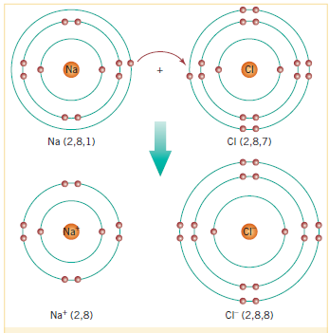
Ionic Bonds
Metal gives electron to non-metal
A Metal empties its valence shell and shrinks in size
A non-metal fills its valence shell and stays the same size

Slide 4
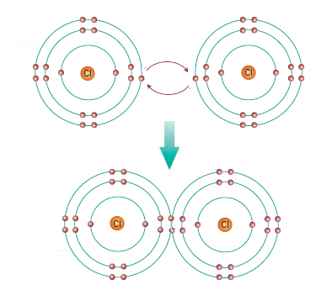
Covalent Bonds
Both non-metals want an electron
They share their electrons to fill each others shells
Electrons that don’t make up the bond are the LONE PAIRS

Slide 5
Ionic or Covalent
MgCl₂
SO₂
HCl
Al₂O₃
O₂
K₂S
NaNO₃
Ionic
Covalent
Covalent
Ionic
Covalent
Ionic
Ionic

Slide 6
Representing Ionic Bonding
Always make sure the charges add up to be neutral
Think of ionic formulas as a ratio between the metal and the non-metal
Ca²⁺
Cl⁻
Cl⁻
1
2
CaCl₂

Slide 7
Representing Covalent Bonding
Lewis Structures

Slide 8
Lewis Structures and Multiple Bonds

Slide 9
Creating a Lewis Structure
Creating CO₂
Determine valence of all atoms
Determine number of electrons required to fill the valence shell
This gives the number of bonds
Place the atom requiring the most bonds in the centre
Include the surrounding valence electrons
Include the surrounding atoms with valence electrons
Connect unpaired electrons
All atoms should have 8 electrons (2 if hydrogen)

Slide 10
Practice Lewis Structures
HBr
Sulfur dichloride
Methane (CH₄)
Nitrogen gas
Ammonia (NH₃)
Hydrogen cyanide (HCN)
Formaldehyde (OCH₂)
Challenge Question
Methanol (H₃COH)

